Slide 1

Capstone 2023
CBDC
Nate Cable, Zee Khan, Dan McClellan, Bella Wang

Slide 2
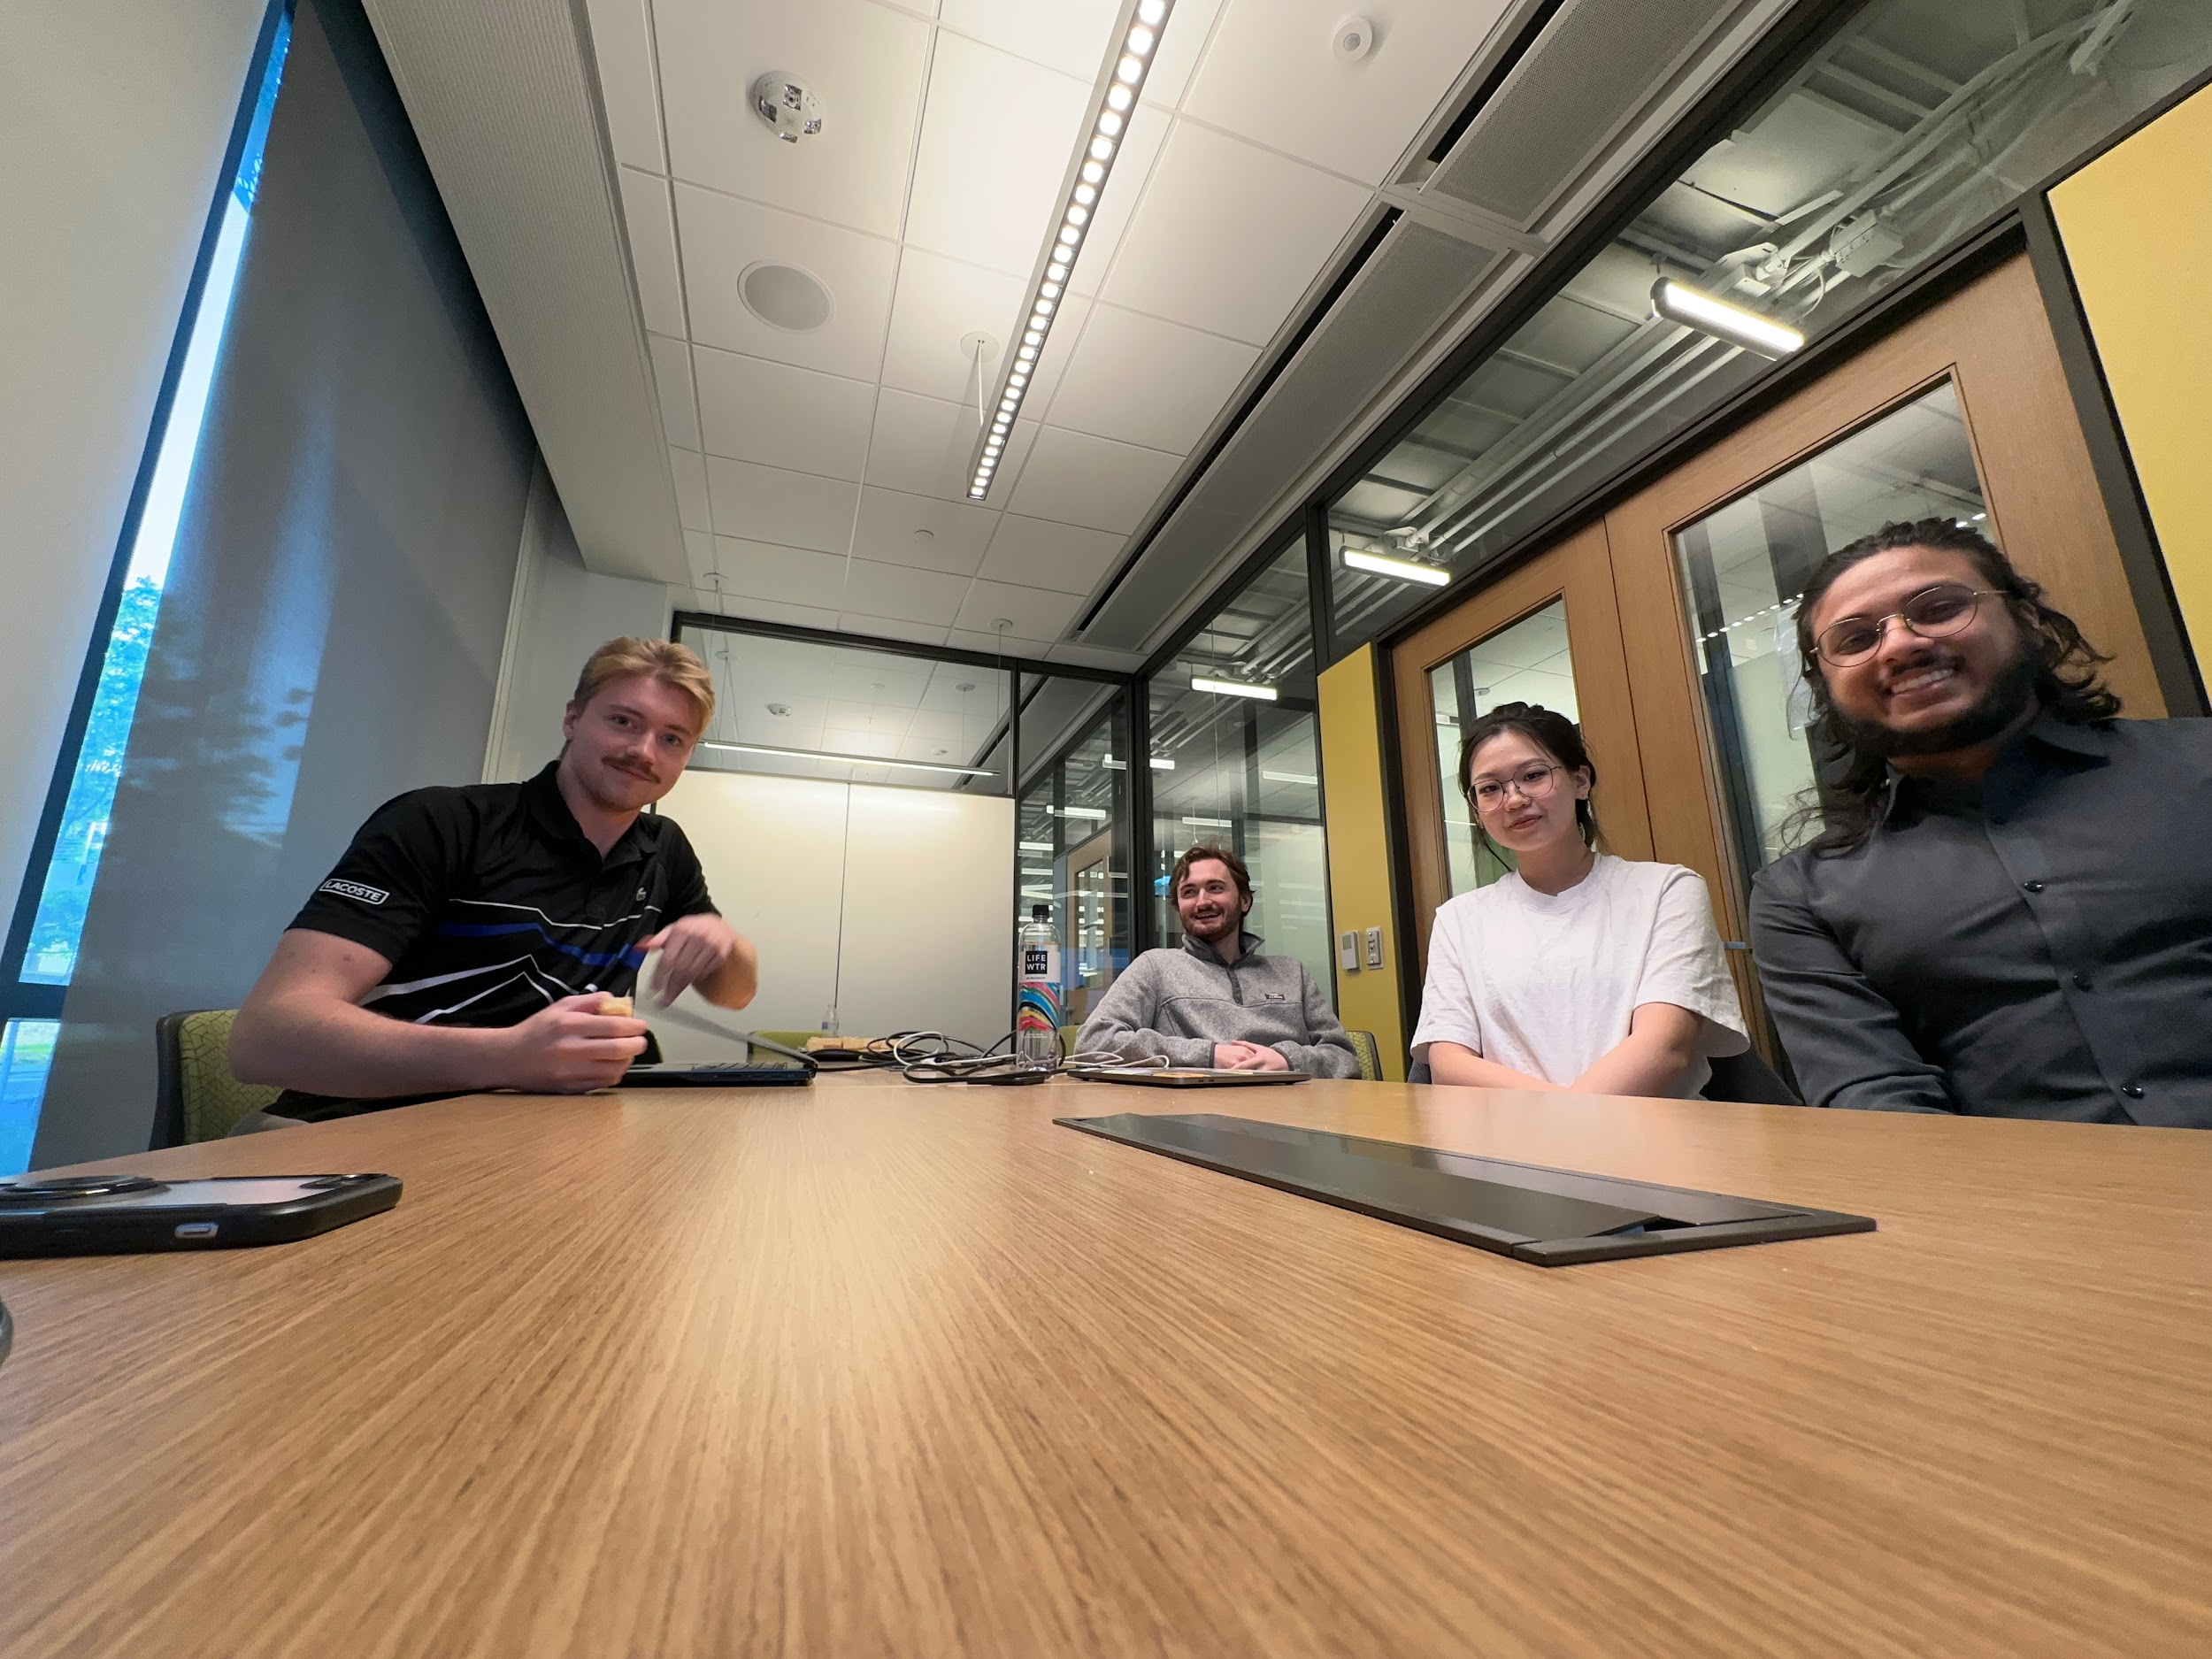

Team Members and Roles
Nate Cable
Zee Khan
Dan McClellan
Zihan Wang
Benchmarking Lead
DevOps Lead
Architecture Lead
Project Manager

Slide 3
In this presentation…
.1
Project Overview
.2
Team Management
.3
Accomplishments & Deliverables
.4
Demo
.5
Plans for Next Semester

Slide 4
.1
Project Overview

Slide 5

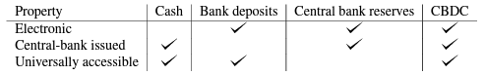
OpenCBDC
Skills acquired in this degree!
The Boston Federal Reserve and MIT DCI: Project Hamilton
Hamilton’s Goals:
Test the technical and economic feasibility of a CBDC
Create an open source system that’s scalable, secure, and efficient
Understand legal, regulatory, and policy implications
OpenCBDC is the result of these goals, and was published with 2 architectures: the Atomizer and the Two-Phase Commit (2PC)
An open-source platform to develop and test CBDC implementations
3 main repositories; the systems, the benchmarking load generators with a frontend, and the AWS IaC
Uploaded alongside a technical whitepaper that goes in-depth about the architectures and design choices

Slide 6

Oracle’s Interests
Skills acquired in this degree!
The white paper discusses the use of an in-memory, distributed key-value store library called LevelDB
Oracle is interested in evaluating the feasibility of utilizing Oracle Cloud tools and replace of LevelDB
Oracle Database
Oracle Compute Instances
Blockchain Tables
Procedures, triggers, and other SQL tools
After implementing these tools at various stages, Oracle would like to get some benchmarks to compare this implementation with that of the one benchmarked in the whitepaper
Notes:
Add new slide after for 4 main steps of process for 2 sems:

Slide 7
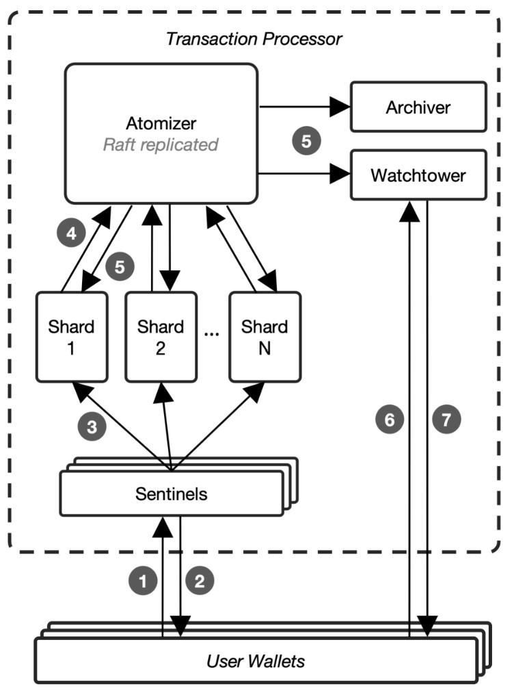
OpenCDBC’s Architecture
Skills acquired in this degree!
Atomizer Design
OpenCDBC was released with two infrastructures
Atomizer and 2PC
Atomizer max. throughput: 170,000 TPS
2PC max. Throughput: 1,700,000 TPS
Notes:
Atomizer transactions are orderer as placed as 2PC varies based on shard communication
Atomizer is async, 2pc is sync
“2PC uses a more complex availability and consistency strategy that relies on replicated state machines for shards and coordinators.”

Slide 8
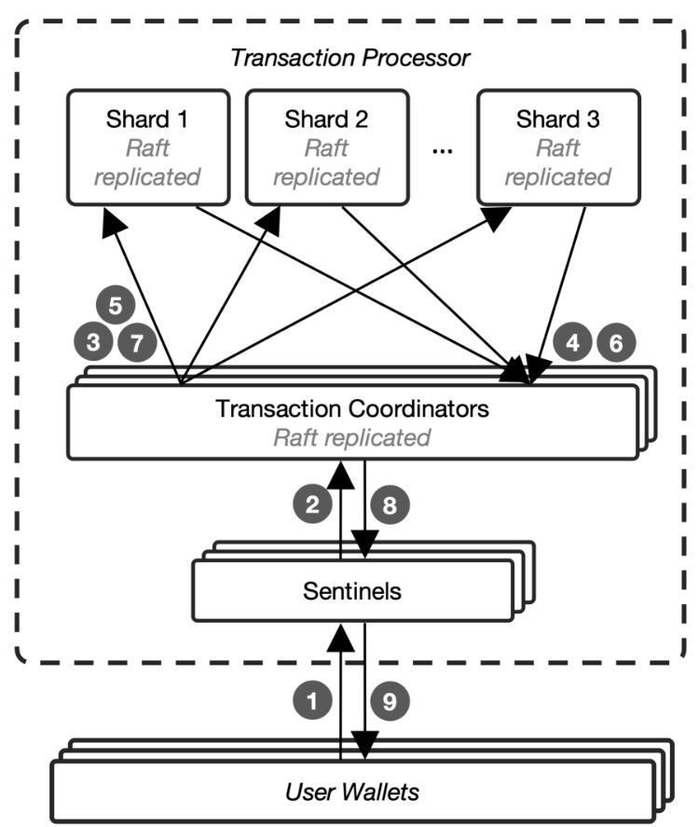
2PC Implementation
Skills acquired in this degree!
Sentinels : submit transactions to coordinator from users and respond with the result of the transaction
Coordinator: receives transactions from the coordinator and start 2PC with shards
Shards: handles the creation of new tokens and deleting the spent tokens

Slide 9
More about 2PC
Shards store USH token hashes and transaction data in memory
Transactions are sent in batches
Sentinels, coordinators, and shards are all independent of one another

Slide 10


Relevant Libraries and Resources
Skills acquired in this degree!`
OCI: backend connection
NuRaft: Raft implementation in C++
Updates the states of all nodes
LevelDB: Distributed Key-Value Storage
Internal storage of raft logs

Slide 11
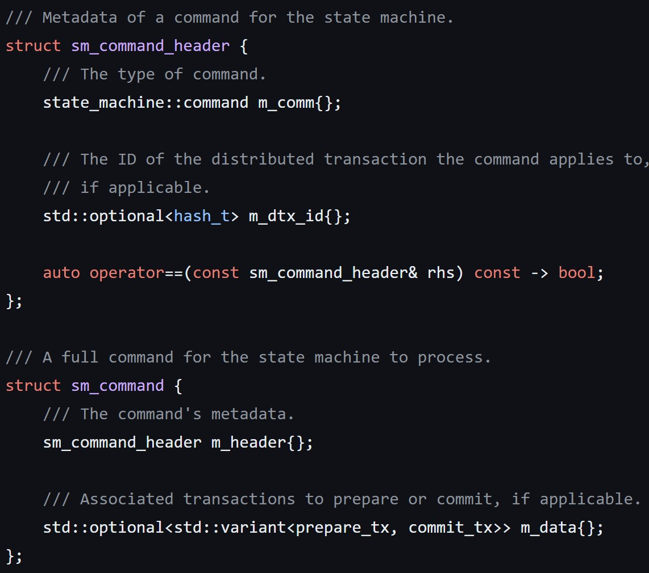
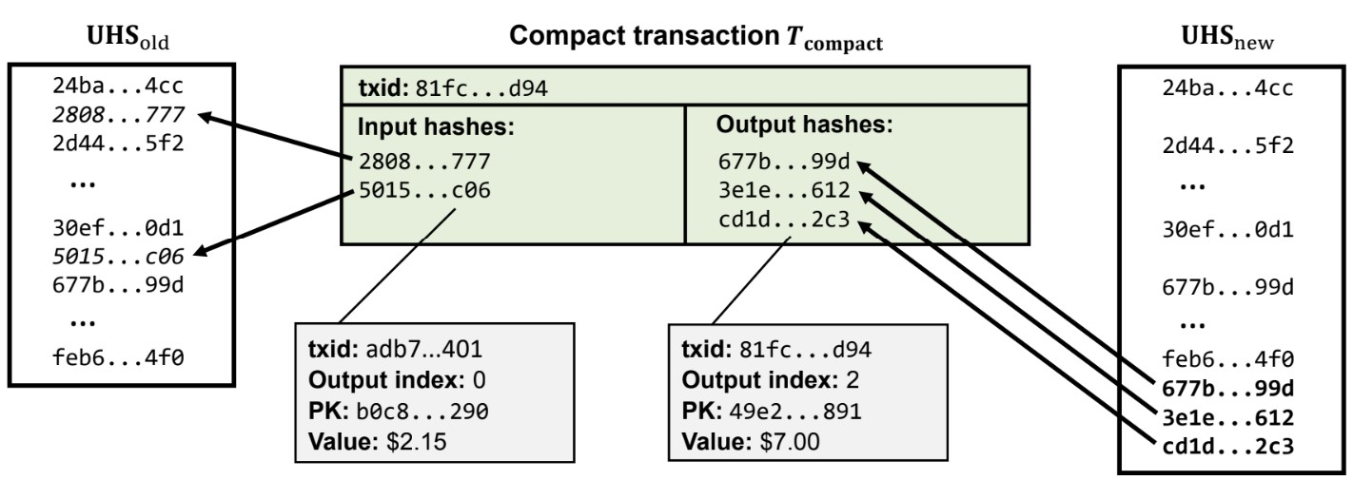
Use of LevelDB in 2PC
LevelDB is used for raft log replication
apply() and write_at() in nuraft’s log_store file are overridden to write to levelDB

Slide 12
Our Work with OpenCDBC
Swap levelDB for Oracle Blockchain tables
Benchmark the effects of Oracle’s impact on the project

Slide 13
.2
Team Management

Slide 14
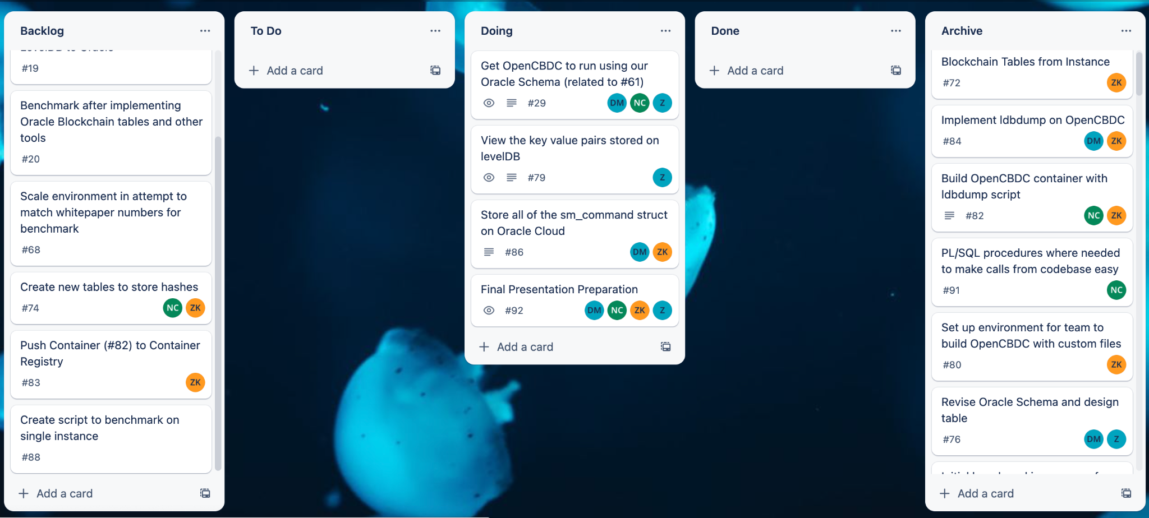
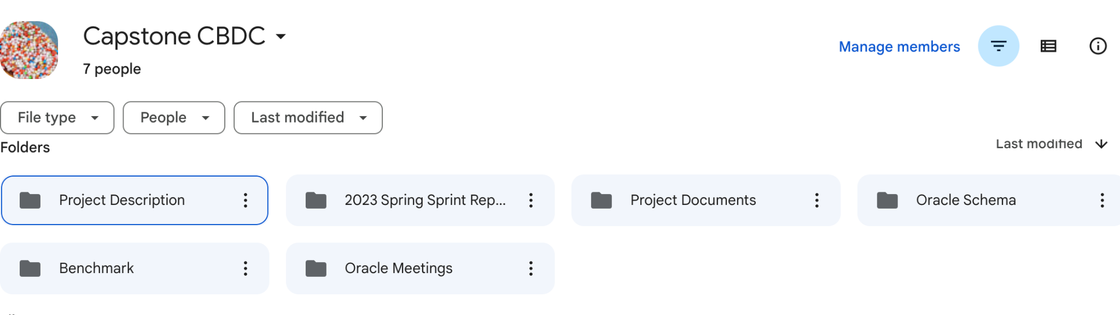
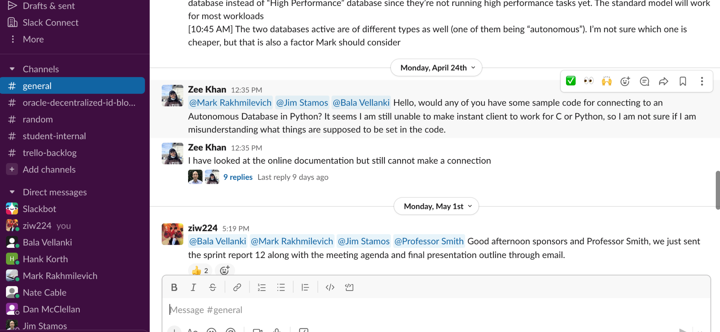
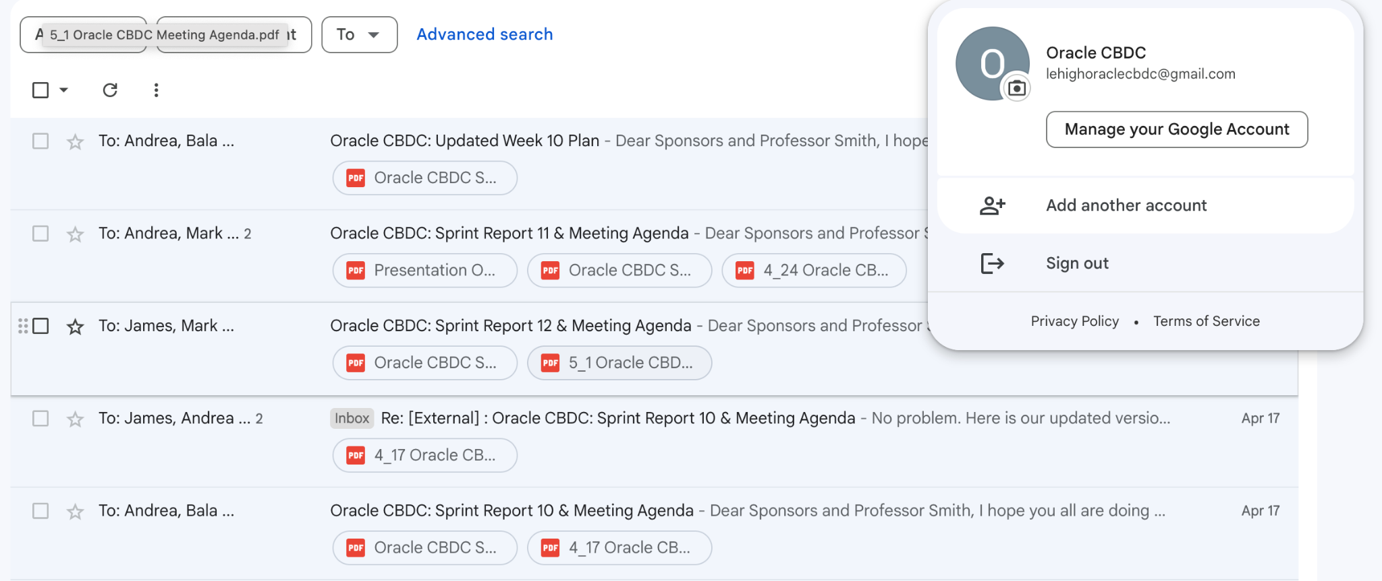
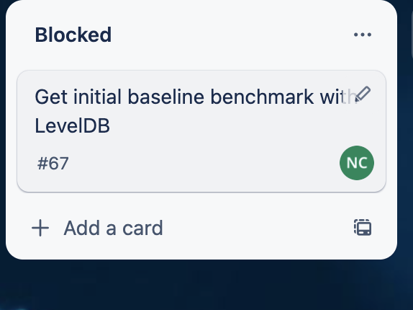
Project Management
Skills acquired in this degree!
Trello Board
Slack
Drive Folders
Group Email
Teamwork Retrospective Implementations

Slide 15
Teamwork
Improvements
In-Person Team Meeting (Every week) - Sprint 7
Work together in-person to
Get immediate responses
Increases both productivity and morale
Assigning each assignment to only one or two people - Sprint 8
Make explicit division of work
Feedback discussion and engage ourselves in “Self-Check” - Sprint 9
Meeting Agenda for Team Meeting - Sprint 11
Stay organized and focused to reduce the chances of getting distracted.
Improve members’ engagement

Slide 16
.3
Accomplishments and Deliverables

Slide 17
Accomplishments and Deliverables
Skills acquired in this degree!
OpenCDBC Oracle Instance
Database and schema
OCI client and server
Benchmarking

Slide 18


OpenCBDC Oracle Instance
Skills acquired in this degree!
Originally, we created an Oracle Linux 8 instance on Oracle Cloud with 8 OCPU’s and 32 GB Memory
After some time of working with the project, we found that there were dependency issues with manually building the project on Oracle Linux
Would take a lot of effort to adjust the build scripts accordingly
A faster solution was to switch our instance to a Debian based distro (Ubuntu, same OCPU and Memory count)

Slide 19
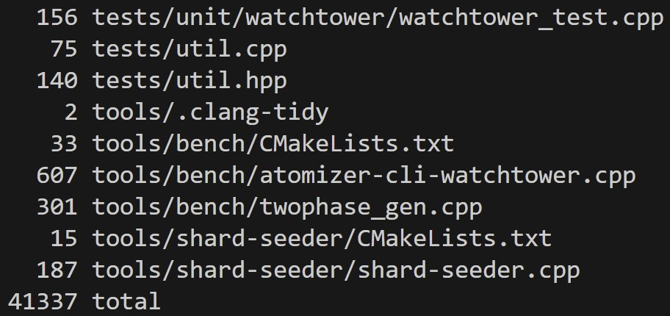
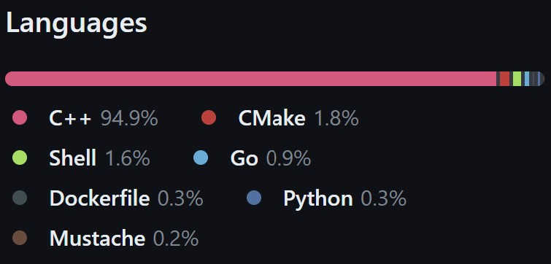
Database and Schema
Skills acquired in this degree!
Goals:
Store key-value pairs on Oracle Blockchain Tables
Minimize Transaction Cost
Create starter PL/SQL procedures
Issues faced:
Size of OpenCDBC repository
Building the project with our changes

Slide 20
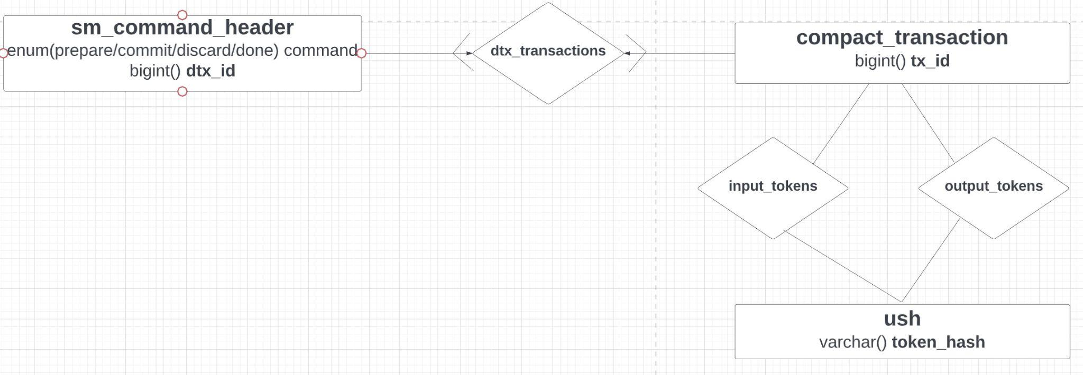
Database and Schema
CREATE BLOCKCHAIN TABLE sm_command_header (
dtx_id NUMBER PRIMARY KEY,
command VARCHAR2(8)
);
CREATE BLOCKCHAIN TABLE compact_transactions (
tx_id NUMBER PRIMARY KEY
);
CREATE BLOCKCHAIN TABLE ush (
tokenHash RAW(16) PRIMARY KEY,
);
CREATE TABLE transaction_input (
transactions_tx_id NUMBER,
token_hash VARCHAR2(64),
FOREIGN KEY (transactions_tx_id) REFERENCES compact_transactions(tx_id),
FOREIGN KEY (token_hash) REFERENCES ush(tokenHash)
);
CREATE TABLE transaction_output (
transactions_tx_id NUMBER,
token_hash VARCHAR2(64),
FOREIGN KEY (transactions_tx_id) REFERENCES compact_transactions(tx_id),
FOREIGN KEY (token_hash) REFERENCES ush(tokenHash)
);
CREATE TABLE dtx_transactions (
blockchain_dtx_id NUMBER,
transactions_tx_id NUMBER,
FOREIGN KEY (blockchain_dtx_id) REFERENCES sm_command_header(dtx_id),
FOREIGN KEY (transactions_tx_id) REFERENCES compact_transactions(tx_id)
);
Notes:
//unspent tokens
SELECT *
FROM ush
WHERE token_hash NOT IN ( SELECT token_hash FROM output_tokens)
//spent tokens
Select * from output_tokens
//get all input of a transaction (with a param)
Select *
from input_tokens
Where tx_id = param
//get all output of a transaction (with a param)
Select *
from output_tokens
Where tx_id = param
//get all the transactions in a batch
Select *
Fom dtx_transactions
where dtx_id = param

Slide 21
OCI Client and C Server
Skills acquired in this degree!
What our goals were
Originally, implement our Autonomous Database connection directly into OpenCBDC
Send content being stored in LevelDB to Database
Issues we faced
Implementation of OCI / OCCI Library into OpenCBDC would take a lot of work with editing extensive build scripts to include wallet and instant client
The scripts for building the project are very complex
Instance had to be changed for dependency issues
Server
DB

Slide 22
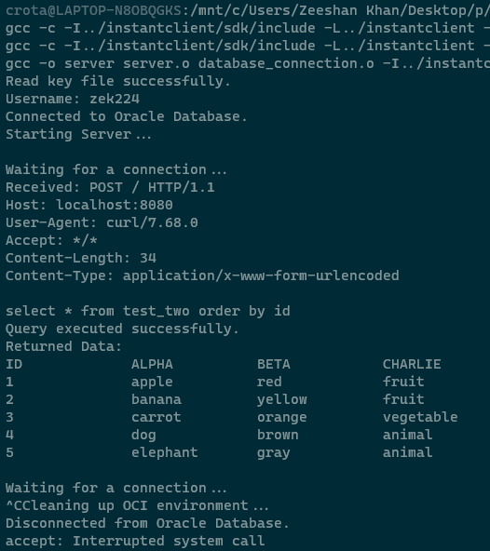
OCI Client and C Server
Skills acquired in this degree!
Where we are at now
Rather, we opted to edit the OpenCBDC code slightly to send POST requests to another Docker container running a C Server
The C Server connects to the Oracle Autonomous Database when run and stays in a loop waiting for connections until closed (SIGINT)
The container listens on an open port (8080) and can be sent strings to execute on the database

Slide 23
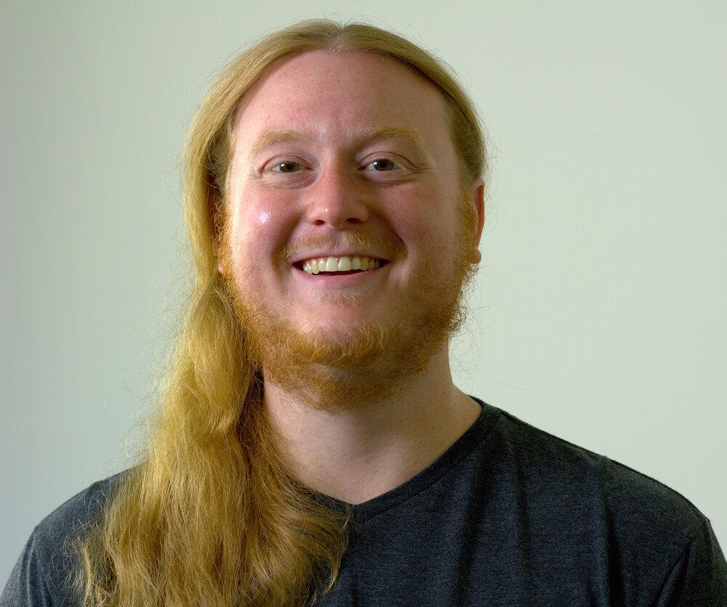
Benchmarking
One of the main goals of the project
Compare our numbers to those in the whitepaper
The Big Problem: AWS Integration
Test Controller
Infrastructure
Contact with OpenCBDC developer Sam
The local benchmarking script
No benchmarks yet, but a solid plan put in place

Slide 24
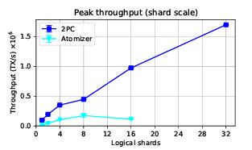
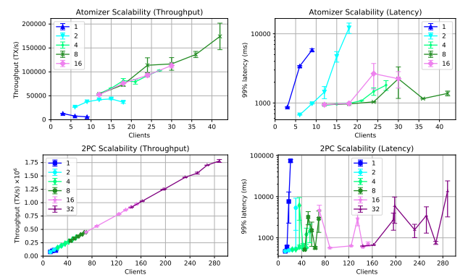
Benchmarking:
Whitepaper Numbers

Slide 25
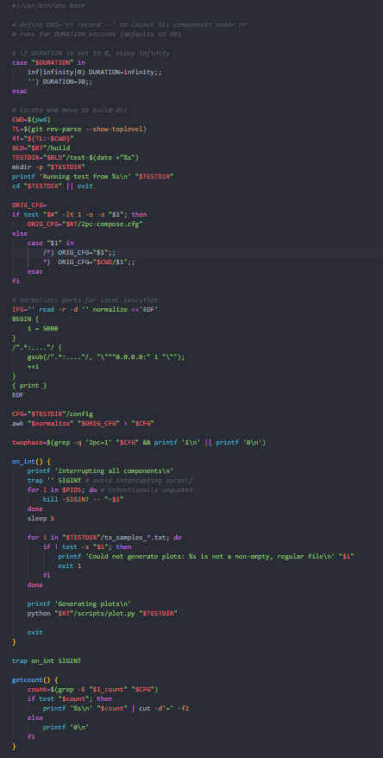
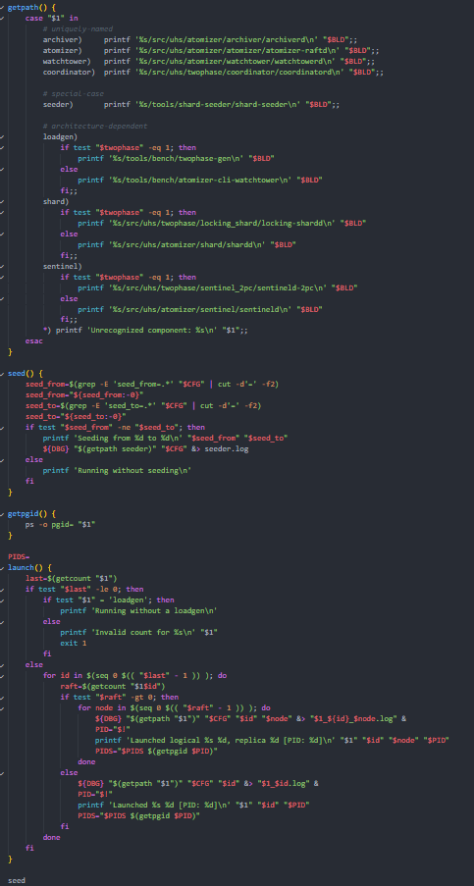
Benchmarking:
Local Script
Runs benchmark all on one machine
Executes outside docker, creating a single process per-component
Takes a config file and executes accordingly
Automatically generates some graphs for the run
Needs small changes next semester to execute properly

Slide 26
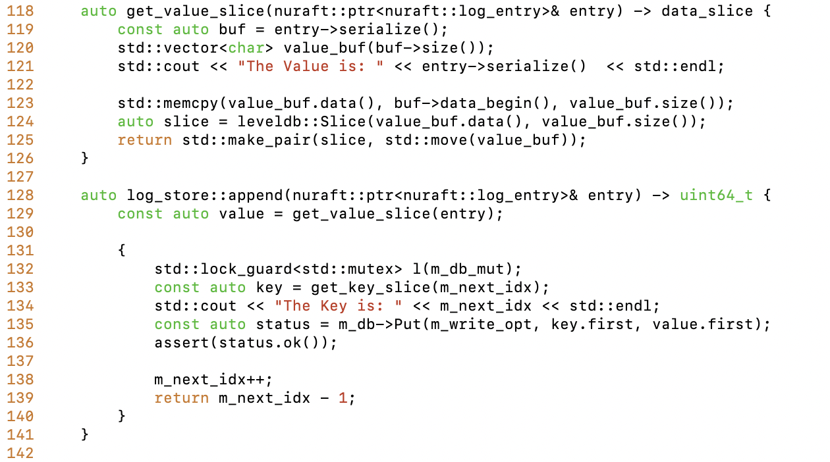
Building the Project
& Viewing the Key-Value Pairs inserted into LevelDB
Key = ID of the current coordinator/ shard node
Value = A serialize “entry”
src/util/raft/log_store.cpp

Slide 27
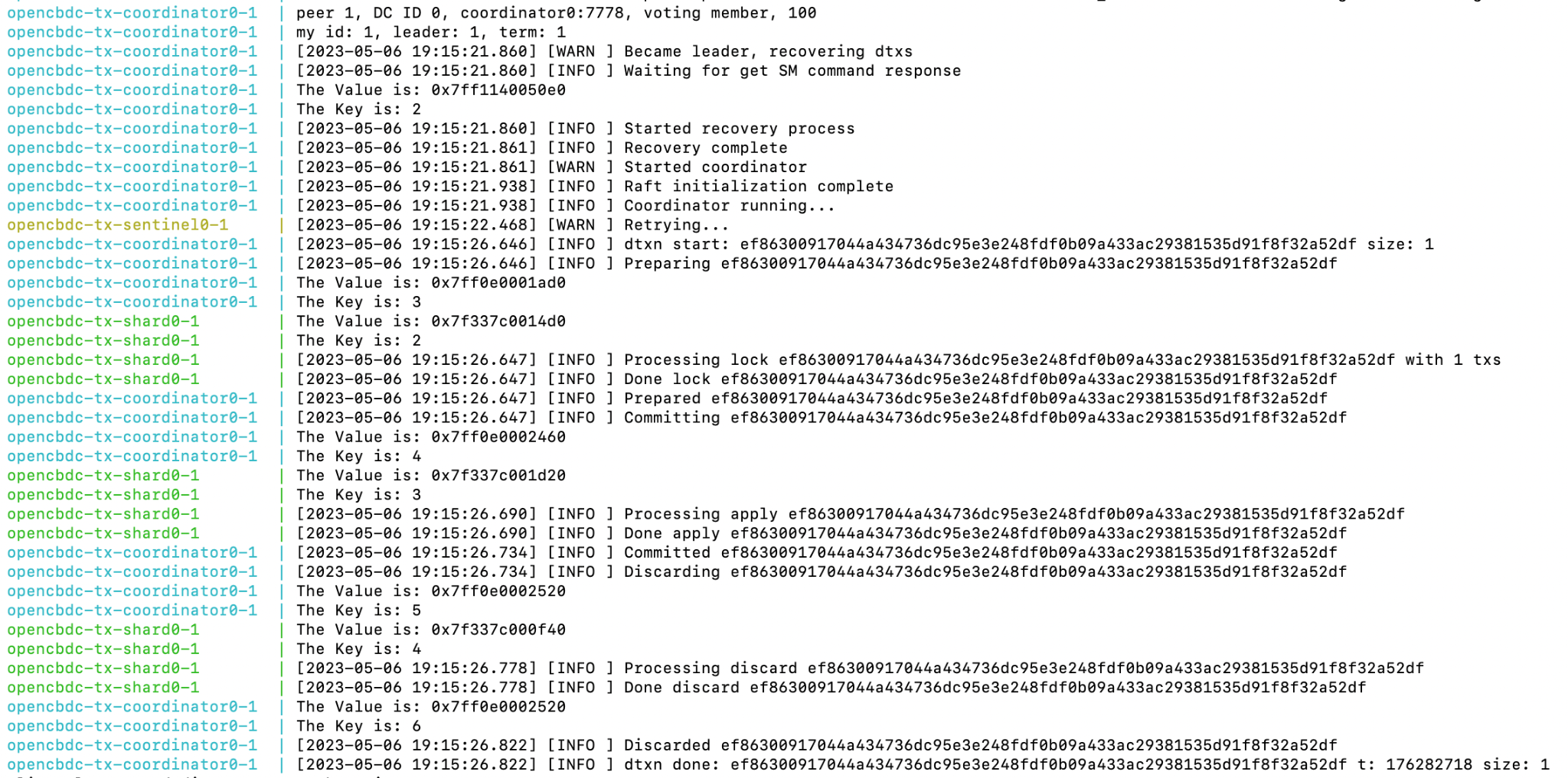
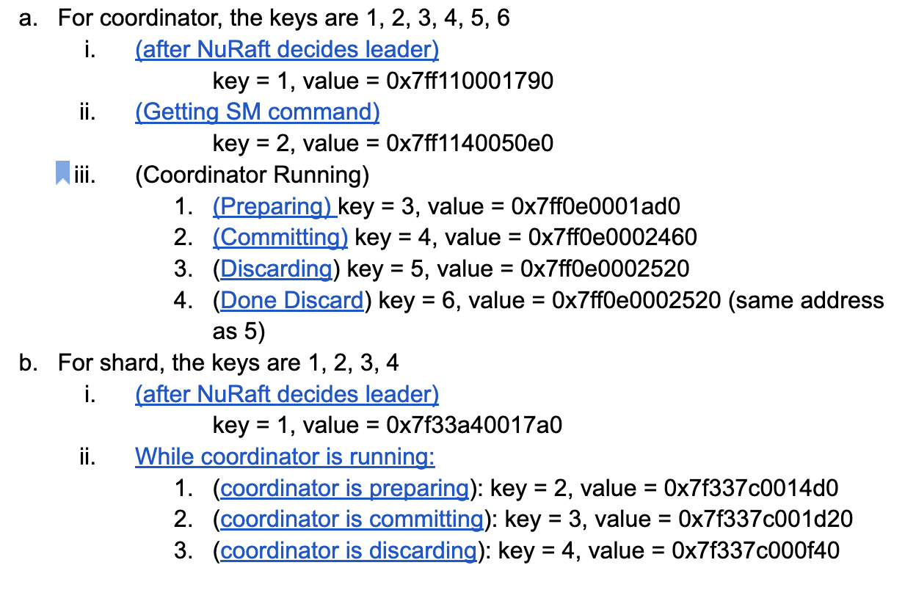
Where we are at now
Key = ID of the current node in coordinators/ shards
Value = A serialize “entry”

Slide 28
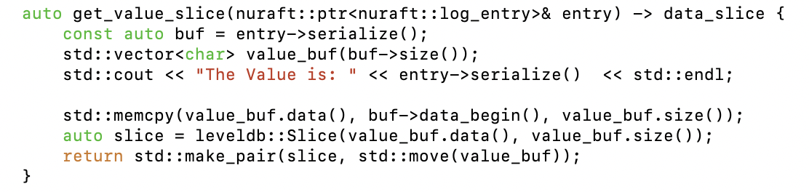
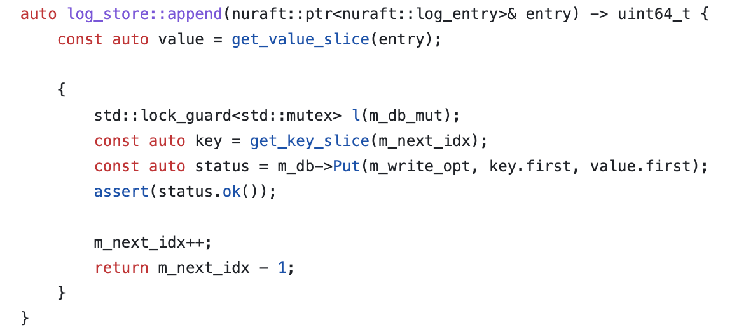
Getting the Value
src/util/raft/log_store.cpp
src/util/raft/log_store.cpp
Get the value of the entry which is passed into this get_value_slice function and serialized

Slide 29
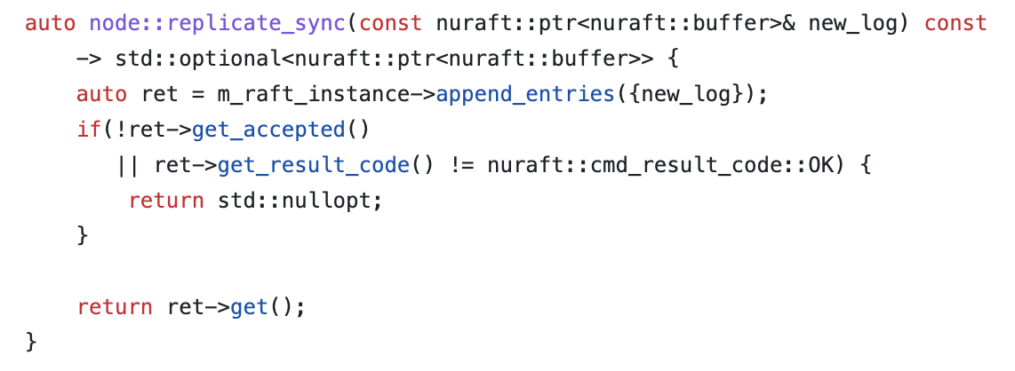
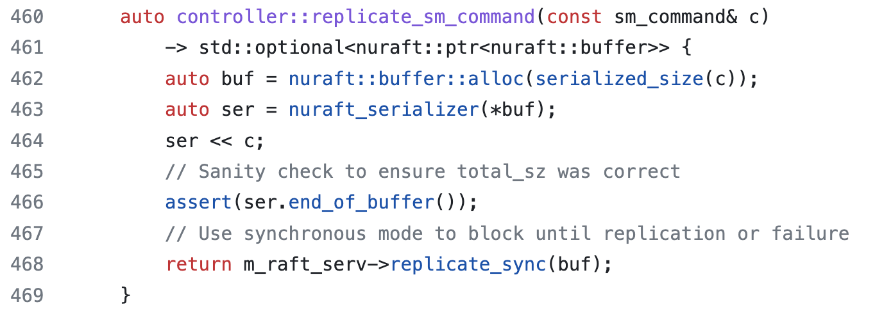
Coordinator
src/util/raft/node.cpp
src/uhs/twophase/coordinator/controller.cpp
In coordinator, it is using the Nuraft nodes to replicate all the coordinator nodes by passing the value of a serialized buffer.

Slide 30
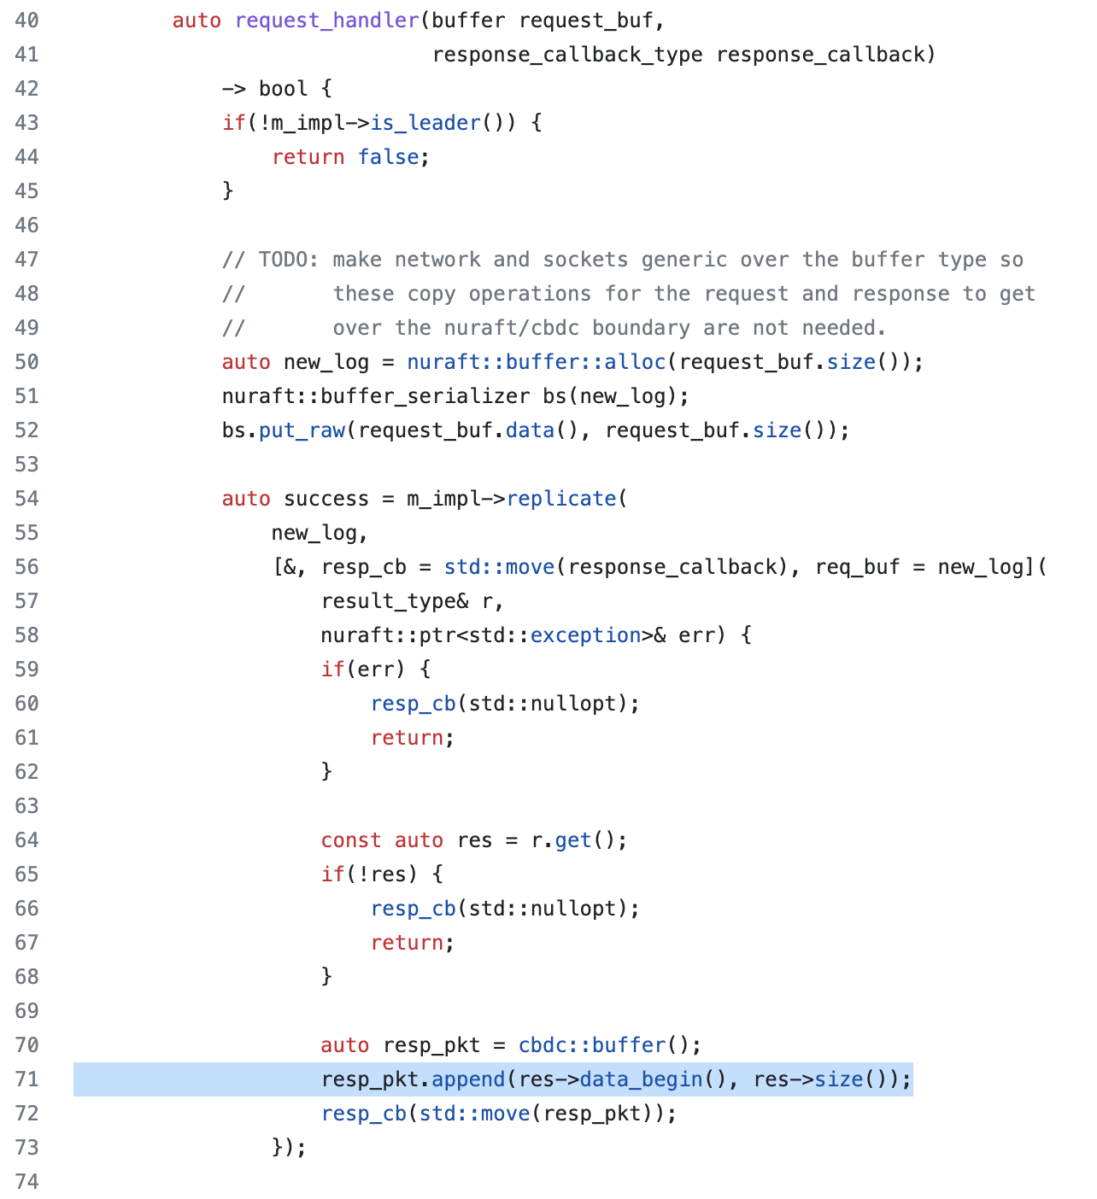
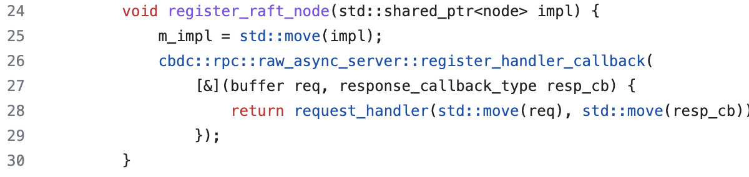
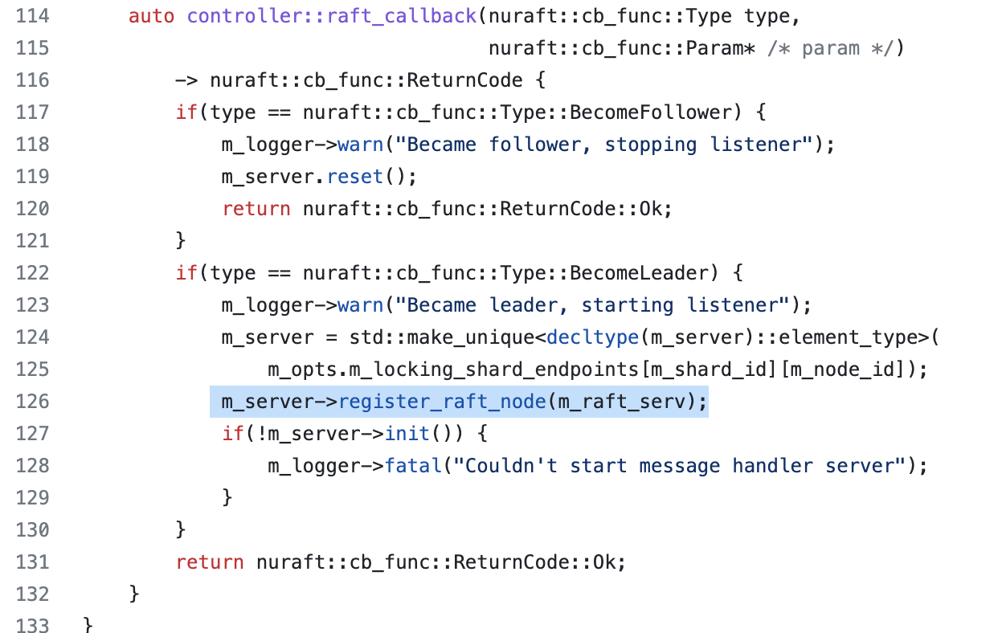
Shard
src/util/raft/rpc_server.hpp
src/util/raft/rpc_server.hpp
src/uhs/twophase/coordinator/controller.cpp
Shard is using the RPC server for replicating the raft nodes

Slide 31
.4
Demo
Notes:
Show our running database, schema, and reset_tables
Demo of system running and touching database
Procedure to show spent or unspent tokens

Slide 32
.5
Plans for Next Semester

Slide 33
OCI Implementation
Changes to make:
Integrate the Autonomous Database connection into OpenCBDC
Phasing out the C Server
Organize the necessary libraries and credentials into the project
Compile project with database connection build in
New file with function calls to connect & prepare statements for the database
Read from our database when state is being reverted

Slide 34

Benchmarking: Overview
Two layers of benchmarking:
A baseline benchmark at different stages of Oracle integration
No integration, still using LevelDB
LevelDB swapped for Oracle Database
Schema updated to use Blockchain Tables where applicable
Integrated use of more tools, such as PL/SQL procedures and triggers
Also interested in each stage scales
Clients (wallets or load generators)
Shards
What are we expecting?
Lower performance than LevelDB
Database connection will always be slower than in-memory storage
Linear throughput scaling, similar to the whitepaper benchmarks
Higher latency numbers due to database connection

Slide 35

Benchmarking: Strategy
Modify the local script
Get the baseline numbers for LevelDB on single instance
Develop our baseline benchmarking procedure
Draft a document on number of shards and clients to involve for the baseline
Will also include what metrics we are gathering, how many trials, and how we extract our final numbers
This process will be used as the baseline for all other stages, ensuring comparable metrics
From here, another document will be drafted on how we scale on each stage
Repeat this process all of the integration
Once these benchmarks are completed at each stage, we will draw our conclusions on how to best implement Oracle tools in the codebase
Notes:
Cut down words

Slide 36
Questions?
Thank you!

